Slide 1
Acquisition 101
Title Procedures

Slide 2
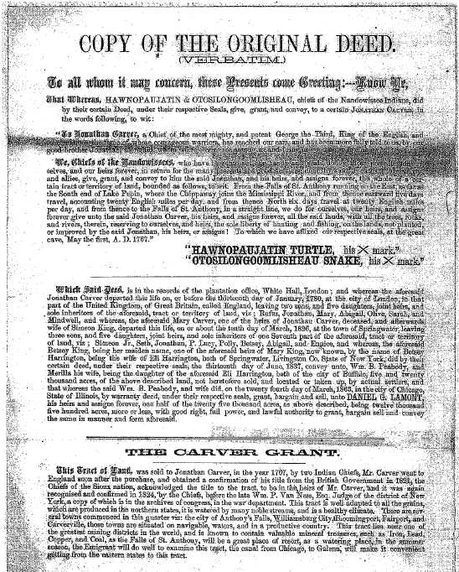
Here’s a deed found in an ODOT Title Report

Slide 3
HOW TO
BECOME PRE QUALIFIED
TO DO TITLES FOR ODOT
AND LPAs
UNDER ODOT’S JURISDICTION

Slide 4
Anyone other than ODOT staff must be pre qualified by ODOT to prepare title reports
● The ODOT Office of Consultant Services maintains the list for consultants and LPA staff
The prequalification requirements are the same for:
● Consultants and LPA staff

Slide 5
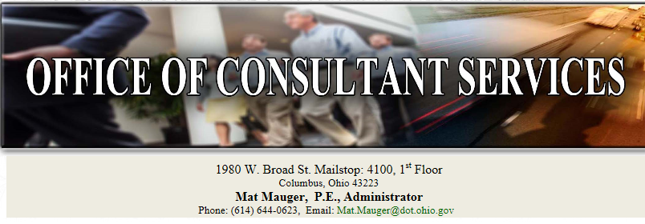
The prequalification requirements are in the

Slide 6
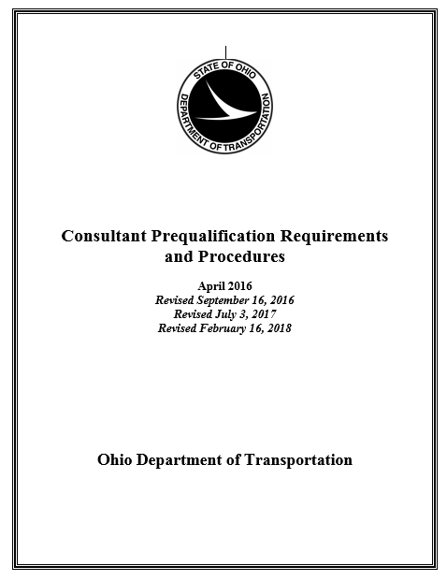
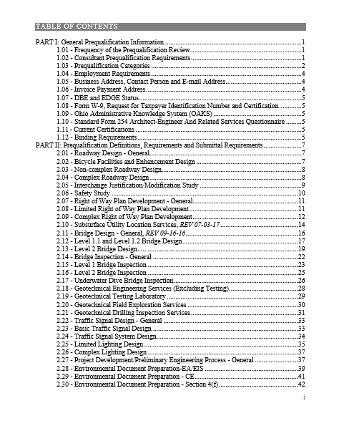
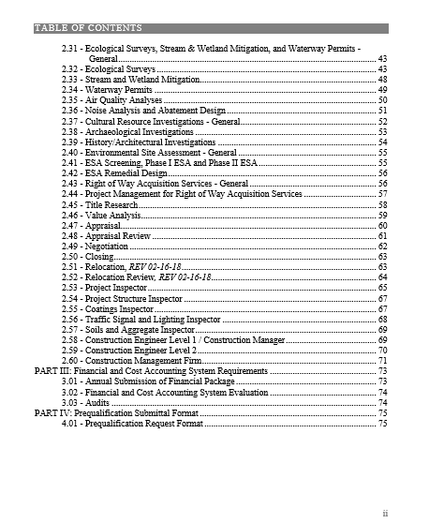
Look at the
Prequalification
Procedures

Slide 7
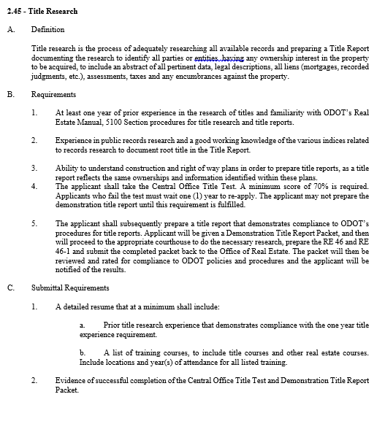
Requirements
- 1Yr Experience
- Familiar with 5100
- Understand hwy plans
- Pass title test
- Submit Title
demonstrating
competence/compliance

Slide 8
THE
PROCEDURES
5100 Section of the
Real Estate Manual
[ Major rewrite occurred on 11/22/2016 ]

Slide 9
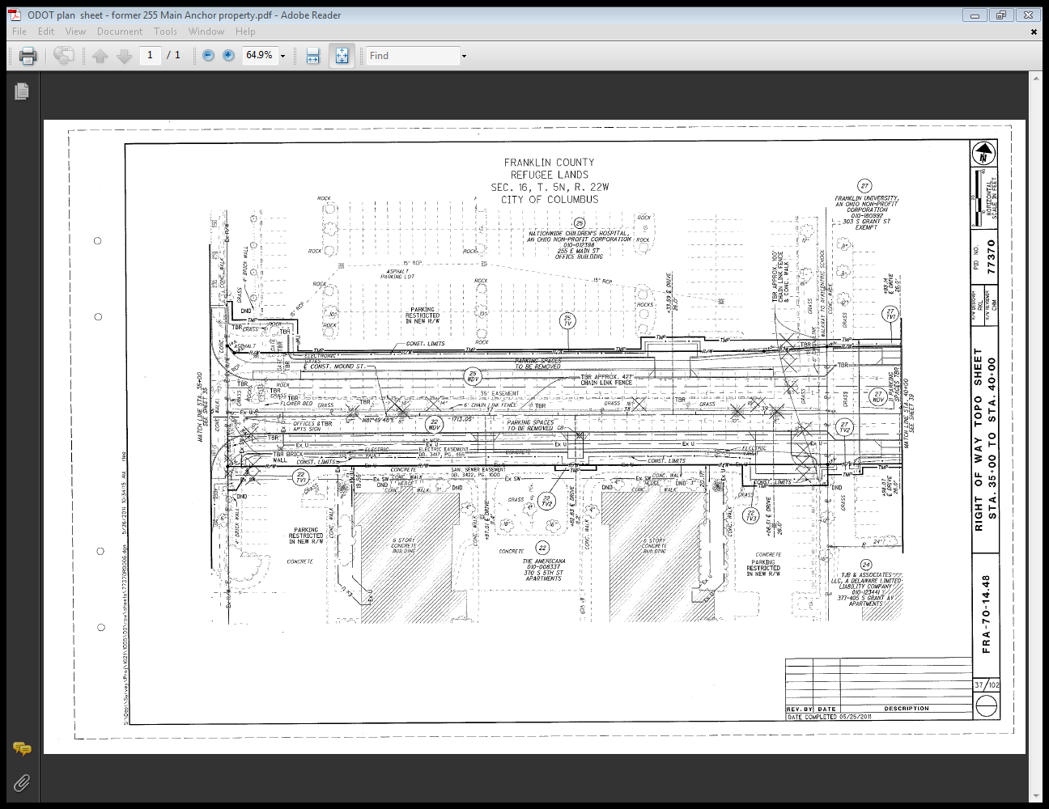
The acquisition of the part taken is subject to ODOT’s power of eminent domain
T
WD
Colored-in areas represent the part taken
The law governing eminent domain in Ohio is ORC Chapter 163
These laws require ODOT to provide the owner several things

Slide 10
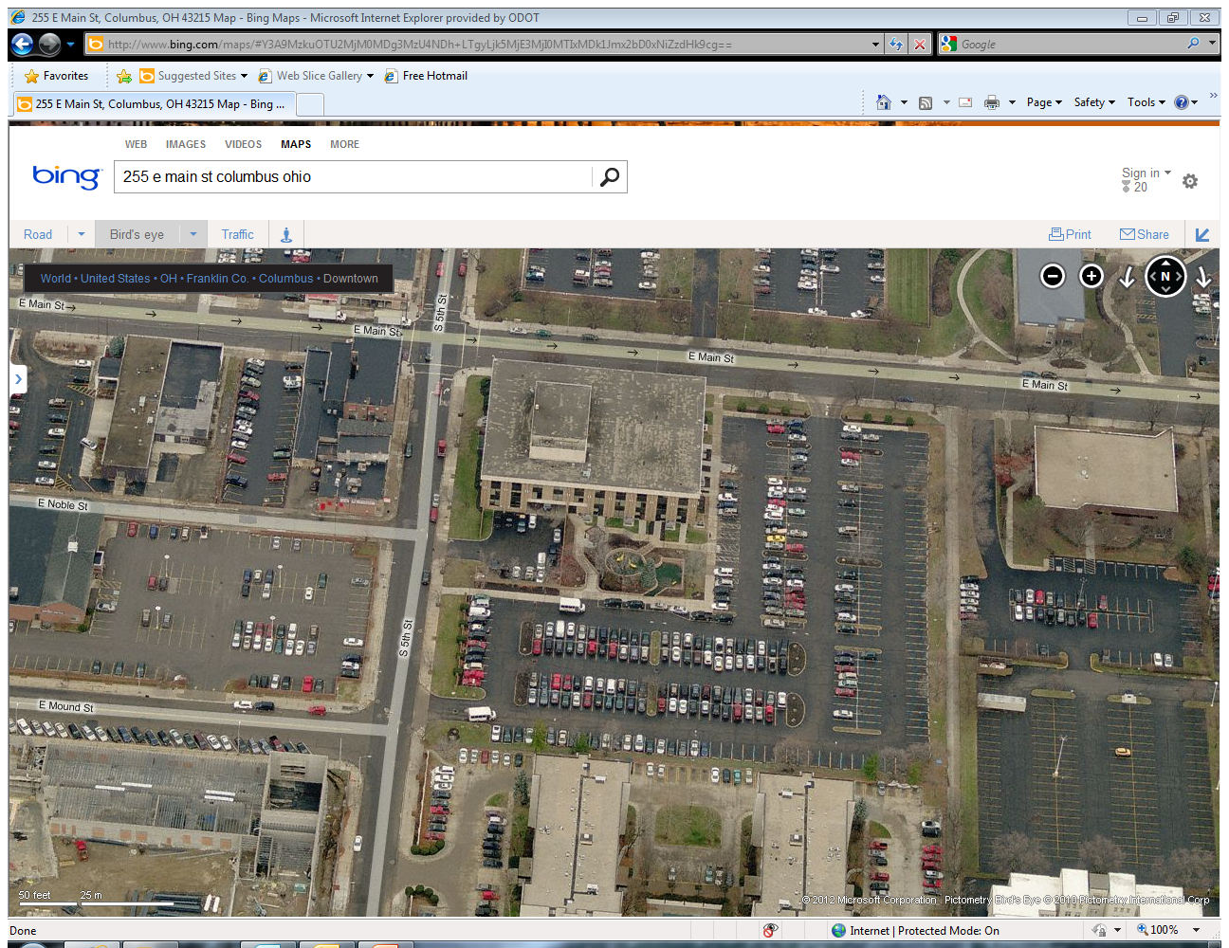
Closed Drive
Non functional
Road Ext
New Drive
WD Take

Slide 11
The ORC requires:
- The owner will be paid for the part taken and damages, if any – ORC 163.06(B)
- The owner will be provided a “Notice of Intent to Acquire” – ORC 163.04(A)
- The owner will be provided a written “Good Faith Offer” – ORC 163.04(B)
The owner will be provided an appraisal at time of offer - ORC 163(C)
The owner is named on an appropriation petition – ORC 163.05
Owners are named on judgment entries
Owners are named on ODOT instruments
Owners are named on contracts for sale and purchase
Owners are named on rights of entry
- Owners are issued warrants for payment of compensation
GET THE OWNER WRONG AND WE HAVE A PROBLEM

Slide 12
Therefore,
The purpose of an ODOT Title Report is to identify all ownership interests in the part taken
An ODOT Title Report is not like a title insurance binder you receive when you purchase a house
It is an abstract that lists all transfers of ownership and encumbrances against the property being acquired

Slide 13
Types of Title Reports used at ODOT
● The 42 Year Title Report
● The Abbreviated Title Report
● The Title Update (apart of the original Title Report – not a separate report)
All Title Reports consist of…
● RE 46 → The Title Report
● RE 46-1 → The Title Chain
● Attachments to the report that are pertinent

Slide 14
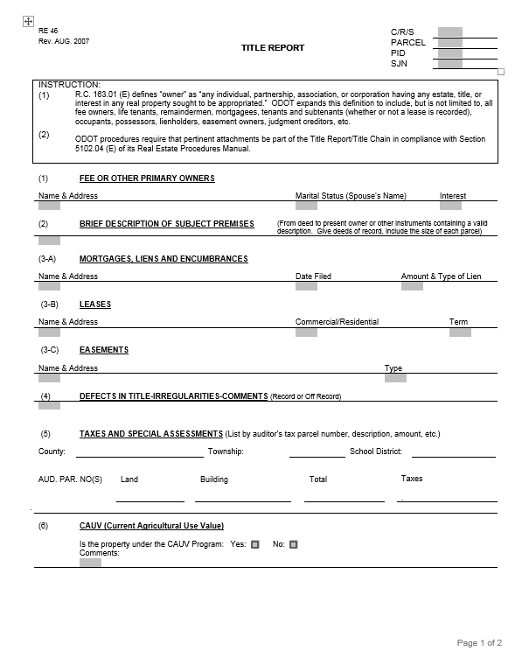
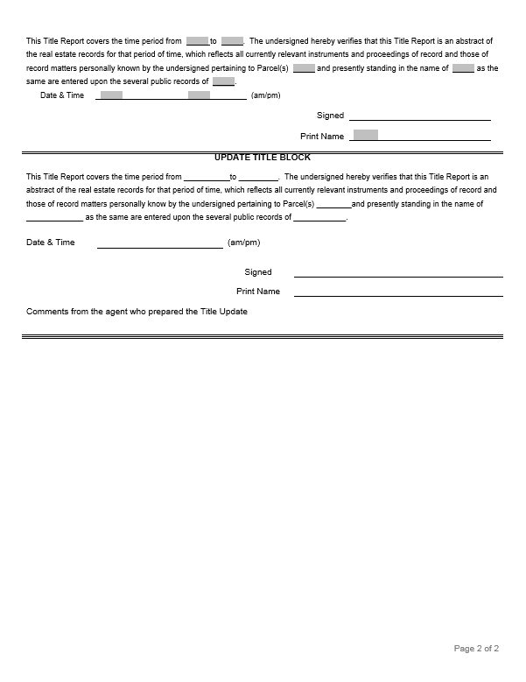
The Title Report / RE 46 / edit date August 2007

Slide 15
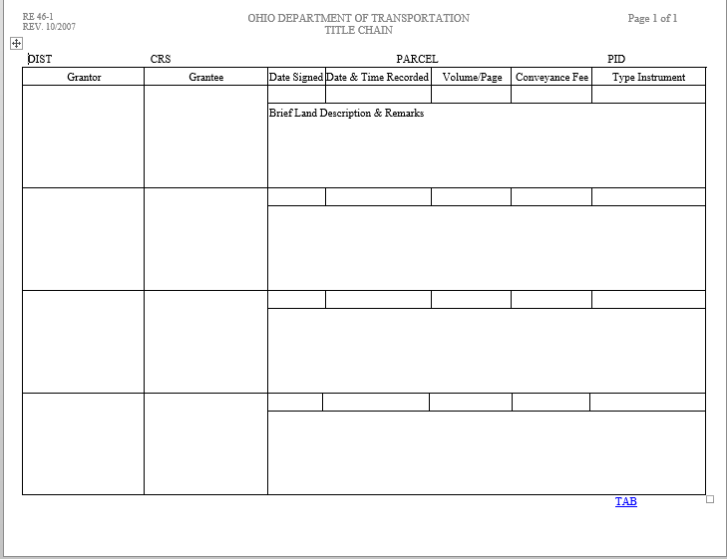
The Title Chain / RE 46-1 /edit date October 2007

Slide 16
What does the term “owner” mean?
RC 163.01 Appropriation of property definitions.
(E) "Owner" means -
any individual, partnership, association, or corporation having any estate, title, or interest in any real property sought to be appropriated.

Slide 17
ODOT has further clarified owner on the RE 46 …
ODOT expands this definition to include, but not limited to,
all fee owners, life tenants, remaindermen,
mortgagees, tenants and subtenants (whether or not a lease is recorded), occupants,
possessors, lienholders, easement owners,
judgment creditors, etc.

Slide 18
Who is the owner based on this information…
- The property is a single family home
- Doug Maitland, currently a married man, is listed as single on the warranty deed.
- 5/3rd Bank is the mortgagee interest – loan originated 5 years ago in the amount of $175,000
- The deed references an easement running along the side of the property providing access to the property behind Maitland’s property
- D. Maitland leased the property to Wayne Pace for 5 years and the lease has run for 2 years.
Who has an estate, title or interest in the property – ORC 163.01(E)?

Slide 19
Entities having an interest in the property:
Fee Owner’s Interest
- Doug Maitland is the fee owner
He is married and still alive, so we don’t have to consider the dower interest
Mortgagee’s Interest
- Maitland originated a mortgage, the mortgage encumbers the property – so the lender has an interest
Easement Interest
An easement interest encumbers the Maitland property, the easement belongs to the rear abutting property
Tenant’s Interest
- Maitland conveyed the right of occupancy to Pace. Pace has the right to occupy for another 3 years

Slide 20
PROCEDURES
THAT ALWAYS APPLY

Slide 21
Every acquisition parcel file has a title report.
All title reports must comply with Section 5100 of the Real Estate Manual.
The title agent shall use the most recent versions of the RE 46 and the RE 46-1.
4. All interests in the property to be acquired are to be identified in the Title Report.
Procedures That Always Apply

Slide 22
At least 1- business day prior to closing or disbursing funds,
- the title report is updated
- to assure there have been no changes since the last report.
For appropriated parcels, the Title Report provided to the AGO is to comply with the “checklist procedures and notification requirements”
– see section 5105 of the procedures
Procedures That Always Apply

Slide 23
The person signing the verification block on the title report (or update) is verifying that he/she is the person who researched the public records.
- It is a breach of procedures for another to sign the report.
Procedures That Always Apply

Slide 24
Title reports are not to contain an opinion of title as this constitutes the practice of law.
- the agent just reports the facts on the report
Any consultant preparing any type of title report must be pre-approved by the ODOT Office of Consultant Services and be listed on their web site as pre approved for titles.
- A consultant pre-approved for the closing function may not update a title report unless he/she is also pre-approved for titles.
Procedures That Always Apply

Slide 25
The title agent is to research all applicable indices within the public records. If these indices are not available on-line, the agent is required to travel to the courthouse.
If the agent is uncertain about the effects of a particular conveyance, he is to make a copy and include that document in the report.
The title agent submits a paper copy and an electronic copy to the district office.
– the copies are to be filled out completely with signatures and attachments
Procedures That Always Apply

Slide 26
13. Information that must be in any report:
●The current owners (including a copy of the deed)
●The interest owned
●The legal description
●When the interest was purchased
●How it was acquired
●From whom it was acquired
●Where it is recorded
●Others who may have a right, title or interest in the
property, or, who use the property
●Whether the property (or any portion of it) is
encumbered
Procedures That Always Apply

Slide 27
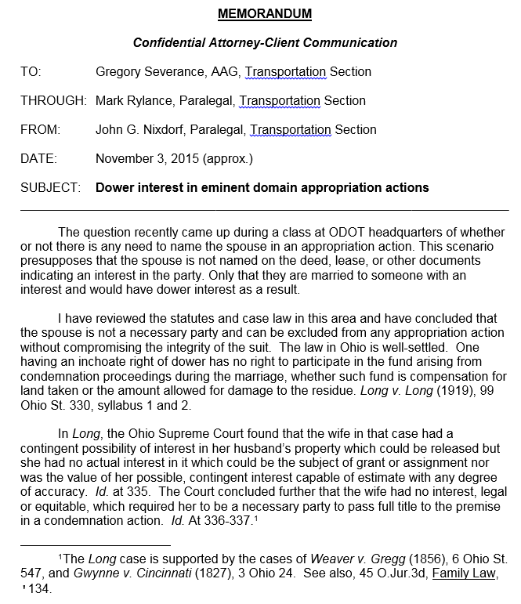
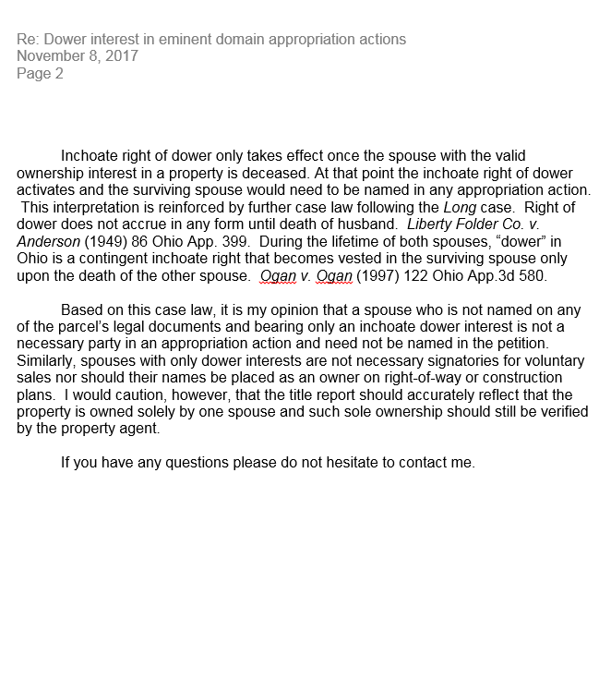
14. Dower Interest
If a spouse is not named on the deed …
The spouse can be excluded from any appropriation action
One having an inchoate right of dower has no right to participate in the fund arising from condemnation proceedings
In summary, a spouse having an inchoate dower interest:
- Does not need to be named on the appropriation petition
- Are not necessary signatories for voluntary sales
- Their names should not be placed on construction plans or right of way plans
Inchoate = “just begun and not so fully forward or developed”
The title report should accurately reflect the property is owned solely by one spouse
- Such sole ownership should be verified by the negotiator
The inchoate right of dower takes effect once the spouse having the valid ownership interest is deceased
At that point the inchoate right of dower activates and the surviving spouse is named in an appropriation action
Procedures That Always Apply

Slide 28
The 42 Year Title Report
Definition:
- The standard title report is the 42 year Title Report that documents the public records search back 42 years (section 5102.02(A) –The Real Estate Manual)
This 42 year standard is for title research necessary to determine ownership with the focus on the part taken.
- The result of this title research is summarized on the ODOT Title Report form.
Title research for creating right of way plans does not adhere to a 42 year standard
Ownership listed on plans is mainly determined from tax maps
This records research is not considered a title report
Records research must comply with OAC 4733-37-02 to determine location of property lines and so on.
The 42 Year Title Report

Slide 29
Is required …
● Anytime the record must be thoroughly searched
● When the Title Report is updated for an appropriation
● When FMVE is not based on the “waiver of appraisal provision” in regulation
Must search the record of title back to a 42 year root of title
● Root of title is defined in section 5101.04
The 42 Year Title Report

Slide 30
Root of Title for a 42 Year Title Report
The most recent deed of conveyance of the entire bundle of rights that describes the property being acquired that has been of record for more than 42 years. This concept is based on Section 5301.47 (E) of the Ohio Revised Code which defines root of title as follows:
The 42 Year Title Report

Slide 31
This is the WD or judicial decree of the entire bundle of rights of the property being acquired that has been of record for more than 42 years
Wayne Pace purchased property from Mark Rylance – March 15, 1969
WD been of record for 47.7 years
Doug Maitland purchased property from Wayne Pace – Jan. 30, 2000
WD been of record for 16.8 years
Another way to look at it:
11/30/2017 – 42 years = 11/29/1975
Now start looking for the most recent WD that transfers the full bundle of rights in the parcel to be acquired that occurred prior to 11/29/75
Current date is – Nov. 30, 2017
10 Acres of Vacant Farm Land
How far back does a 42 year title search need to go?
A. 03/15/1969
20 ft. wide WD take
Road
B. 01/29/1958 [1/30/2000 - 42 years]
C. 01/30/2000 Date of last Warranty Deed or Judicial Decree

Slide 32
How far back does a 42 year title search need to go?
Parcel A
Parcel B
Parcel C
1 fee owner of an assemblage
Wayne Pace purchased property from Mark Rylance – March 15, 1969
Fred Smith purchased property from Frank Brown – May 1, 1960
Alvin Kline purchased property from Anita White - – April 1, 1955
1 title report having 3 title chains
Each chain must have root title
Parcel A runs from
11/30/2017 → 03/15/1969
47.7 years
16.8 years
11.75 years
6.25 years
Parcel B runs from
11/30/2017 → 05/01/1960
55.6 years
Doug Maitland purchased property from Wayne Pace – Jan. 30, 2000
Doug Maitland
purchased from Fred Smith – March 1, 2005
Doug Maitland
purchased from Alvin Kline – Sept. 1, 2010
Parcel C runs from
11/30/2017 → 04/01/1955
60.7 years
10 Acres of Vacant Farm Land
10 Acres of Vacant Farm Land
10 Acres of Vacant Farm Land
20 ft. wide WD take
Road
Current Date is Nov. 30, 2017

Slide 33
Parcel A
Parcel B
Parcel C
How far back does a 42 year title search need to go?
Wayne Pace purchased property from Mark Rylance – March 15, 1969
Fred Smith purchased property from Frank Brown – May 1, 1960
Alvin Kline purchased property from Anita White Brown – April 1, 1955
1 fee owner [Greg Severance] has a property that splits into 3 chains
48.1 years
56 years
61.1 years
1 title report with 3 chains
Doug Maitland purchased property from Wayne Pace – Jan. 30, 2000
Doug Maitland
purchased from Fred Smith – March 1, 2005
Doug Maitland
purchased from Alvin Kline – Sept. 1, 2010
17.1 years
12.1 years
6.6 years
Doug Maitland sold Parcels A, B and C to Greg Severance on Dec. 15, 2017
4 months
20 ft. wide WD take
Road
Current Date is March 15, 2018

Slide 34
● If root title cannot be determined, the district is to engage another title agent – see FAQ No. 11, section 5107
● “Root of Title” is the deed(s) of conveyance of the entire bundle of rights describing the property to be acquired
- It must be a warranty deed and/or a judicial decree that transfers the entire bundle of rights in the parcel.
The 42 Year Title Report

Slide 35
Procedure for Completing
the Title Report / RE 46
______________________
Section 5102.03 of the
Real Estate Manual
The 42 Year Title Report

Slide 36
The top of the RE 46
The current version of the RE 46
Project information from Right of Way Plans
The 42 Year Title Report

Slide 37
From section 1 of the RE 46
Procedural instructions from section 5102.03 of the Real Estate Manual
● List name, as used in deed, by which title was acquired
● Do not need to search or list mineral right ownerships if the acquisition parcel is reserving mineral rights to the owner – this must be noted in Title Report
The 42 Year Title Report

Slide 38
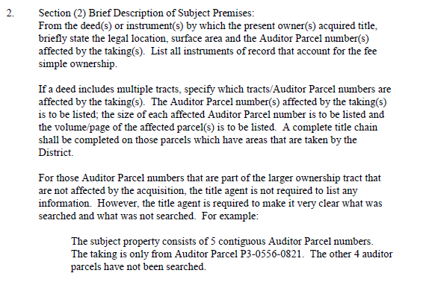
From Section 2 of the RE 46
Procedures from
section 5102.03 of
Real Estate Manual
● From deed by which owner acquired title , briefly state:
- Legal Location
- Surface Area
- Auditor Parcel No.
that are affected by the taking
The 42 Year Title Report

Slide 39
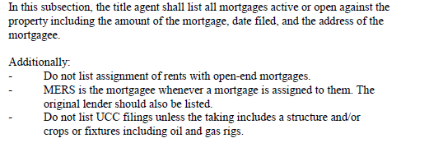
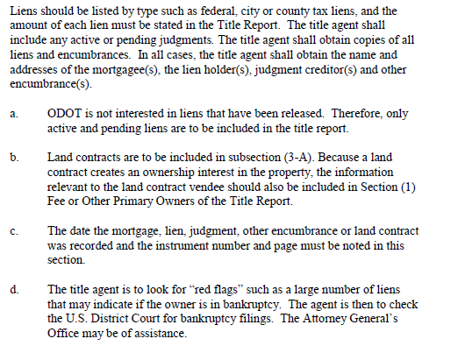
From Section 3A of the RE 46
Procedures from Real Estate Manual
● List all mortgages active or open against the property, including:
- Amount of mortgage
- Date filed
- Address of mortgagee
- Instrument number and page
● Not interested in liens that have been released
● Look for red flags such as a large number of liens; may indicate the owner is in bankruptcy. Then check U.S. District Court for bankruptcy filings.
The 42 Year Title Report

Slide 40
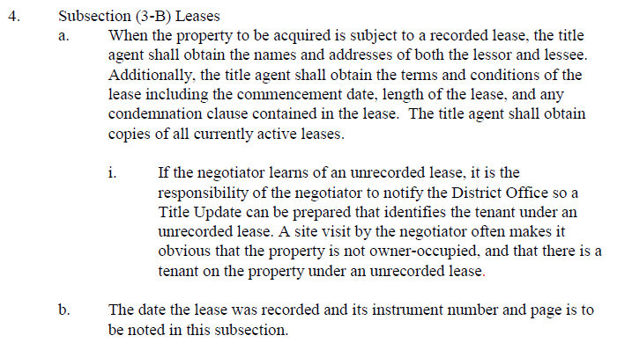
From Section 3B of the RE 46
Procedures from RE Manual
No leases of record for time period searched
● Obtain:
- The names and addresses of the lessor and lessee
- Terms and conditions of the lease such as
Start date
Length of lease
Condemnation clause
The 42 Year Title Report

Slide 41
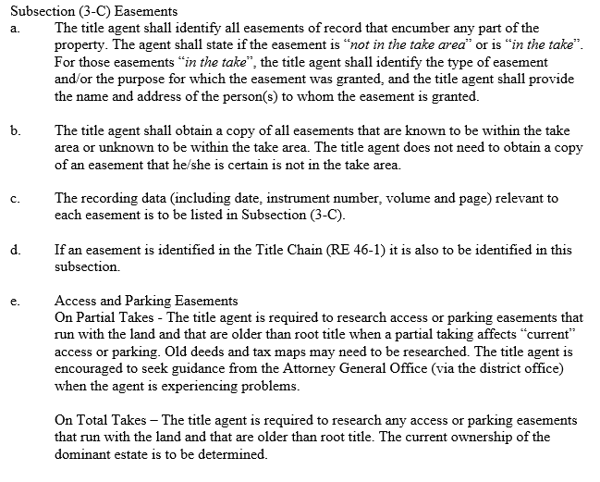
From Section 3C of the RE 46
Instructions from the RE Manual
Identify all easements that encumber any part of the property
- Note if easement is “not in the take” or “in the take”
For easements “in the take” , state:
Type of easement
Purpose of the easement
- Name/address of the person to whom the easement is granted
Obtain copies of easements known to be in the take or unknown to be in the take
Do not need copies of easements that are known not to be in the take
List recording data for each easement
Access and Parking Easements
On Partial Takes - The title agent is required to research access or parking easements that run with the land and that are older than root title when a partial taking affects “current” access or parking. Old deeds and tax maps may need to be researched. The title agent is encouraged to seek guidance from the Attorney General Office (via the district office) when the agent is experiencing problems.
Access and Parking Easements
On Total Takes – The title agent is required to research any access or parking easements that run with the land and that are older than root title. The current ownership of the dominant estate is to be determined.
The 42 Year Title Report

Slide 42
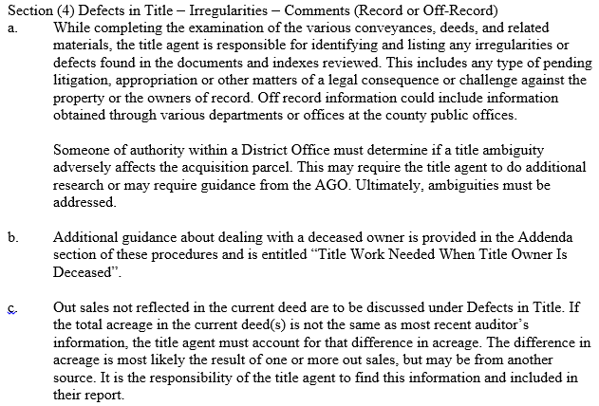
From Section 4 of the RE 46
Procedures from the RE Manual
● Examples of defects / irregularities are:
- Pending litigation
- Appropriation
- Any matter of legal consequence
- Any challenge against the property
● Out sales not reflected in the current deed are to be discussed

Slide 43
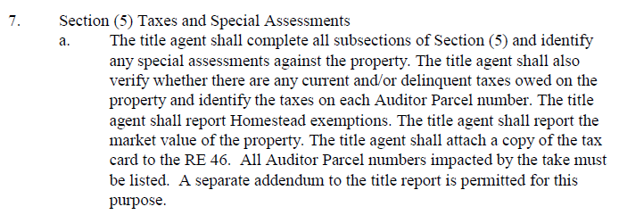
From Section 5 of the RE 46
Instructions from RE Manual
● Fill out the form and:
- Verify if there are any current/delinquent taxes
- Report Homestead exemptions
- Report the market value of the property
- Attach the tax card to the RE 46
The 42 Year Title Report

Slide 44
From Section 6 of the RE 46
Instructions from the RE Manual
● Important because the acquiring agency must pay any recoupment penalty determined by the Auditor – R.C. 5713.34
The 42 Year Title Report

Slide 45
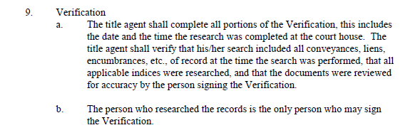
From the “Verification Block” of the RE 46
Instructions from RE Manual
The record was searched from 08-20-2015 to 10-12-52 = 61.9 years
● The title agent is verifying:
- That their research included all conveyances, liens and encumbrances of record
- That all applicable indices were researched
- All documents were reviewed for accuracy
The 42 Year Title Report

Slide 46
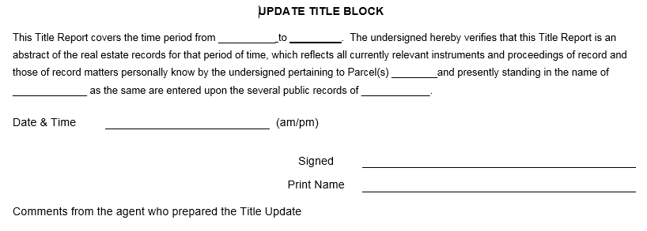
From the “Update Title Block” of the RE 46
● The update block is incorporated into the RE 46 form
- There is a separate update block for each update of a Title Report
The 42 Year Title Report

Slide 47
Temporary Easements
When the acquisition parcel is only a T
And it does not adversely affect the residue
And it is of typical duration (6 months – 2 years)
The title agent need not research the record for
Mortgage information
Or any lien of any kind
Or tax information and CAUV
All other parts of the Title Report need to be completed
The 42 Year Title Report

Slide 48
Mini Case Study:
A Deed
from
an ODOT Title Report
The 42 Year Title Report

Slide 49
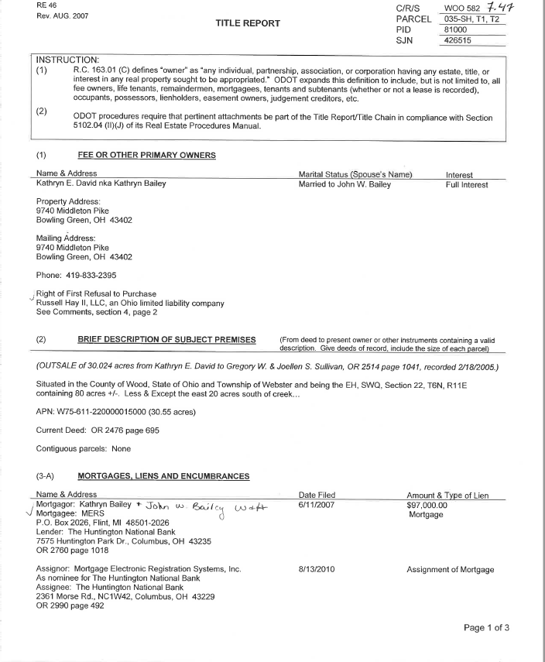
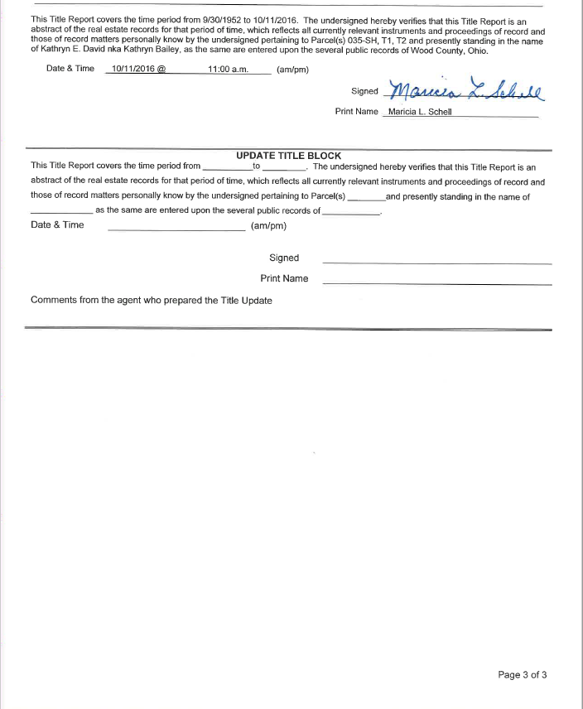
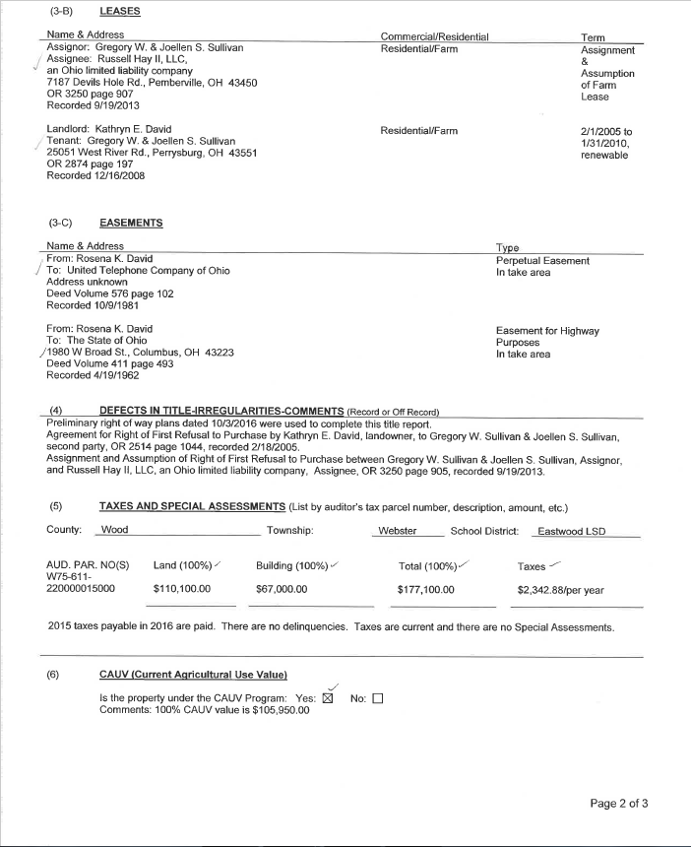

Slide 50
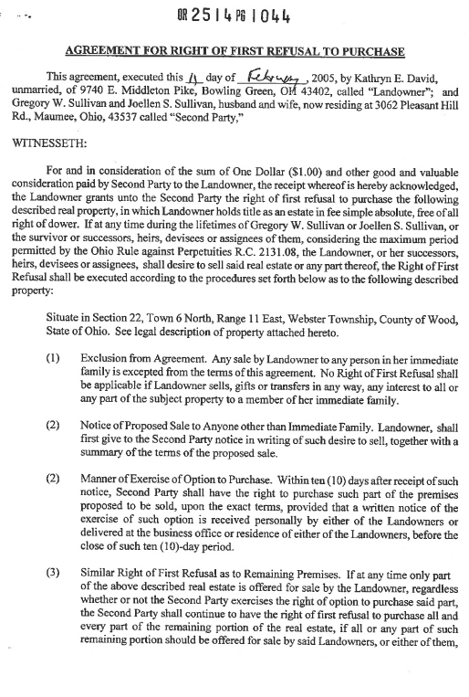
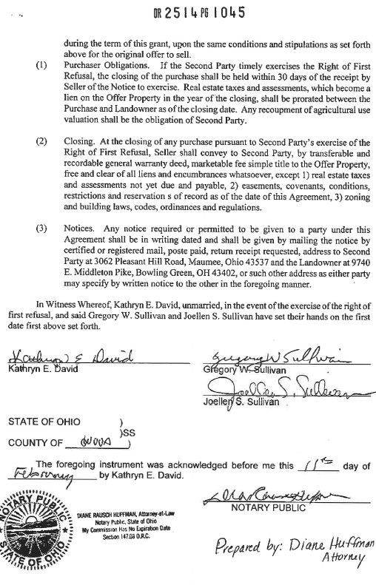
On 02/11/2005, Kathryn E. David grants to Gregory W. Sullivan and Joellen S. Sullivan (H&W) the first right of refusal to purchase 30.223 acres

Slide 51
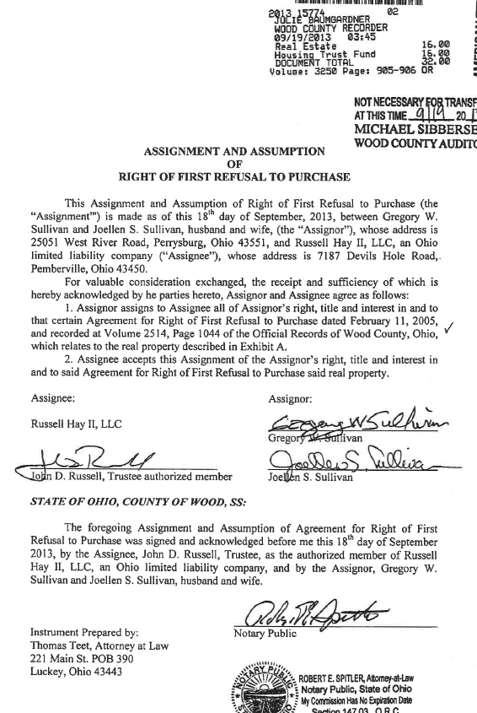
On 09/18/2013 Gregory W. Sulliavn and Joellen S. Sullivan assign to Russell Hay II, LLC all right, title and interest in that certain Agreement for Right of First Refusal to Purchase dated 02/11/2005

Slide 52
Based on this Title Report, who receives ODOT’s offer of compensation?
A. Kathryn E. David
B. Kathryn E. David and the Sullivans
Kathryn E. David, the Sullivans and Russell Hay
Kathryn E. David and Russel Hay
With assistance from the AGO, the NIAGFO is amended to include disclosure that the acquisition is subject to eminent domain, is not a voluntary sale on the part of the fee owner and that the first right of refusal agreement is not nullified and still encumbers the residue property.
On another case, ODOT was acquiring a small strip take, FMVE was $1,205.
● The fee owner had assigned a first right of refusal in 1979
The 42 Year Title Report

Slide 53
Fee owner would not sell without permission of the person holding the first right of refusal
● The holder of this right was uncooperative in negotiations
ODOT had to appropriate
- The right of refusal is a contractual right, not a property right
- The contract is not being appropriated
- Nor is the subject of it being destroyed
The appropriation settled at the FMVE amount
The 42 Year Title Report

Slide 54
The Title Chain / RE 46-1
____________________
Section 5102.04 of the
Real Estate Manual
The 42 Year Title Report

Slide 55
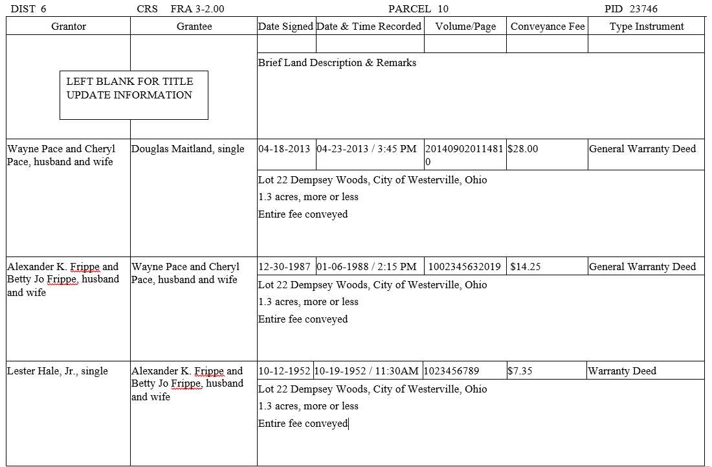
The Title Chain (part of the Title Report)

Slide 56
Procedures for Title Chain
- A completed Title Chain must be included in every Title Report
- The Title Chain reflects the various transfers of the property tracing ownership back at least 42 years for most parcels.
The 42 Year Title Report

Slide 57
Attachments
to the Title Report
The 42 Year Title Report

Slide 58
“Attachments to the Title Report” are detailed in 5102.04(E) of the Real Estate Manual
The deed(s) or other instruments by which the current owner obtained title plus copies of all deeds / conveyances / instruments/easements of record that account for all interests in the property for the current owner.
Anything mentioned in the Title Chain (RE 46-1) needs to be attached to the Title Report. This includes all deeds listed in the title history chain.
The deed or other instrument or court order or judgment entry evidencing root title.
Attachments to Title Report

Slide 59
Every deed or other instrument that contains a reverter clause, restrictive covenant and/or exception.
Every deed or other instrument that creates a life estate.
Every lease, especially any condemnation or eminent domain clause contained in the lease.
The pertinent pages of all mortgages which at a minimum include:
first page, legal description, condemnation clause, signature page, address of the mortgagee, and anything else considered relevant.
Attachments to Title Report

Slide 60
Anything else considered unusual, pertinent or germane in developing and supporting the Title Report and its Title Chain
The tax map and tax card for the current owner.
The pertinent data relevant to any pending litigation affecting the property
Copies of any out sales that have direct influence on the acquisition parcel
Attachments to Title Report

Slide 61
THE ABBREVIATED
TITLE REPORT
______________________
Section 5103 of the
Real Estate Manual

Slide 62
Parcel A
Parcel B
Parcel C
Wayne Pace purchased property from Mark Rylance – March 15, 1969
Fred Smith purchased property from Frank Brown – May 1, 1960
Alvin Kline purchased property from Anita White Brown – April 1, 1955
Standard 42 Year title search:
Parcel A → 1969
03/15/18 → 12/15/17 → Parcel B → 1960
Parcel C → 1955
48.1 years
56 years
61.1 years
Doug Maitland purchased property from Wayne Pace – Jan. 30, 2000
Doug Maitland
purchased from Fred Smith – March 1, 2005
Doug Maitland
purchased from Alvin Kline – Sept. 1, 2010
17.2 years
12.1 years
6.6 years
Doug Maitland sold Parcels A, B and C to Greg Severance on Dec. 15, 2017
For an abbreviated title search:
03/15/18 → 12/15/17 (STOP)
4 months
20 ft. wide WD take
Road
Current Date is March 15, 2018

Slide 63
The standards for the Abbreviated Title Report are similar to the 42 year title except,
the agent need only research the records back until the most recent warranty deed or judicial decree is found that documents the full fee ownership interest of the part taken.
There is no set minimum number of years the research must cover. The record must be researched back until root title is found. This could be 1 year or 100 years based on the definition of root of title for an abbreviated title report.
The Abbreviated Title Report

Slide 64
May be used when the FMVE will be based on the waiver of appraisal provision.
- Waivers are used when it is clear that a taking causes no damage to a residue property and compensation will not exceed $10,000.
- These acquisitions have uncomplicated valuation problems having low amounts of compensation.
- The valuation format is known as a Value Analysis (VA)
- As a result, the risk of a limited title search is acceptable to ODOT.
The Abbreviated Title Report

Slide 65
The (DREA) may deviate from procedure using the appraisal waiver threshold under the following conditions:
- An Abbreviated Title Report may be used for partial takings when the Value Finding Report will be the basis for FMVE
- The approval may be of a single parcel, a group of parcels or of an entire project. The approval to use the abbreviated title is limited to a maximum FMVE amount per parcel of $65,000. The DREA may also approve the use of an abbreviated title for FMVE that is less than this amount
- DREA documents approval to deviate from procedure
The Abbreviated Title Report

Slide 66
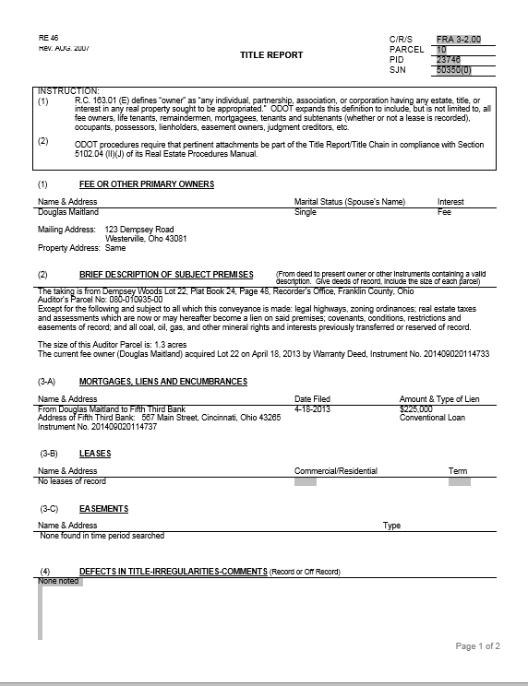
The Abbrev Title Report
Root title was found to
be 04-18-2013
All information on report
reflects from 04-18-2013
forward to the
current date
The Abbreviated Title Report

Slide 67
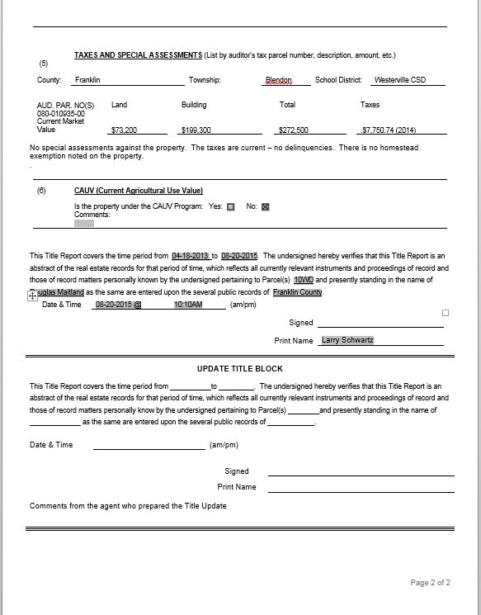
The record was
searched from the date
of root title to the
current date
From 08-20-15 to
04-18-2013 = 1.3 years
The Abbreviated Title Report

Slide 68
THE TITLE UPDATE
______________________
Section 5104 of the
Real Estate Manual

Slide 69
A Title Update is used …
● To determine any changes since the original title report or the last update of the report
● The information put onto the update is to be sufficient to the point allowing the reader to understand any changes that have occurred during the update period
● The title update is prepared by a title agent
● The update is part of the RE 46
The Title Update

Slide 70
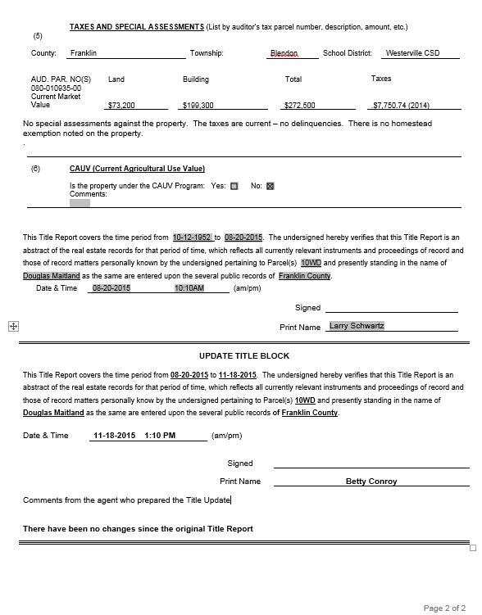
The verification block for the update is at the end of the RE 46, and is the “Update Title Block”
The Title Update

Slide 71
The time period for the update is…
● Verification date of original report to the verification date of the current update
A title update is completed before any compensation is paid to an owner or…
● before any file is forwarded to the AGO for an appropriation
● If the original title report was an abbreviated report, the update must meet the standards of a 42 year title and must comply with section 5105 of the Real Estate Manual – “Title Procedure for Appropriation”
The Title Update

Slide 72
The title update builds on the original title report/RE 46.
The original title agent submitted an electronic - fully executed and completed RE 46
● The person preparing the update will be provided this electronic copy
● The update agent will search the records from the current date back to the date of the original report
The Title Update

Slide 73
The agent will denote changes by striking out information that is changed...
● And will insert the correct information
The agent will detail the duration of the search and sign the update block.
The Title Update

Slide 74
The agent will note in the block if there were changes (or not) since the original title report.
A signed paper copy of every Updated Report is kept in every acquisition file.
New attachments are to be part of the updated report.
The district is again provided a signed paper copy and a fully executed electronic copy.
The district is to be notified immediately of any changes.
The Title Update

Slide 75
Time period searched
from current date: 11-18-2015
to date of original search:
08-20-2015
Date of original title search
Title Update Information
The Title Update

Slide 76
A Second Update
The Title Update

Slide 77
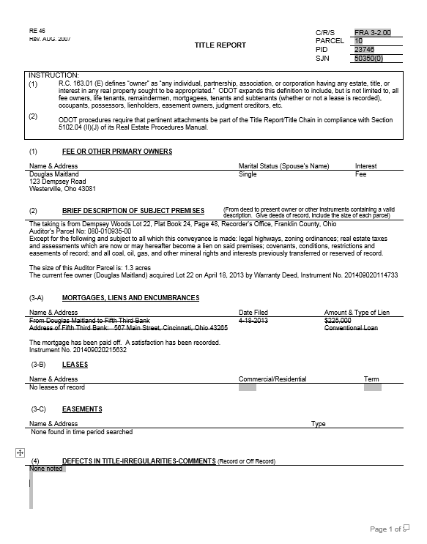
Changes are reflected
with strike outs
Note the change
The Title Update

Slide 78
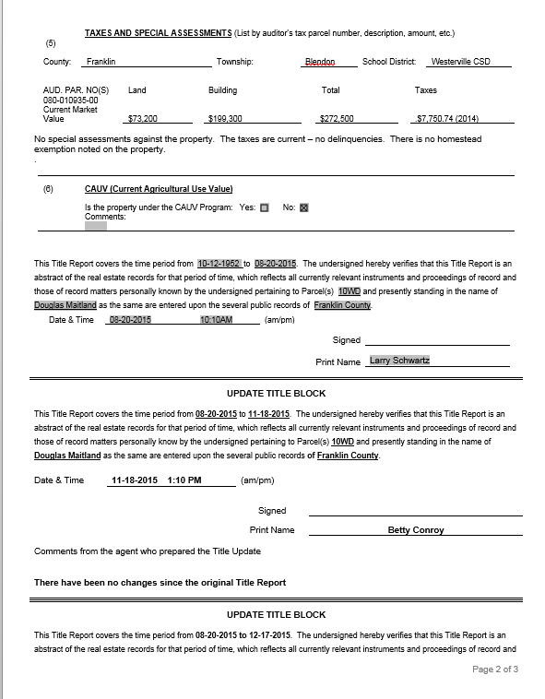
The 2nd update block
inserted in the RE 46.
Time period searched
from
current date: 12-17-2015
to
date of original
search: 08-20-2015
The Title Update

Slide 79
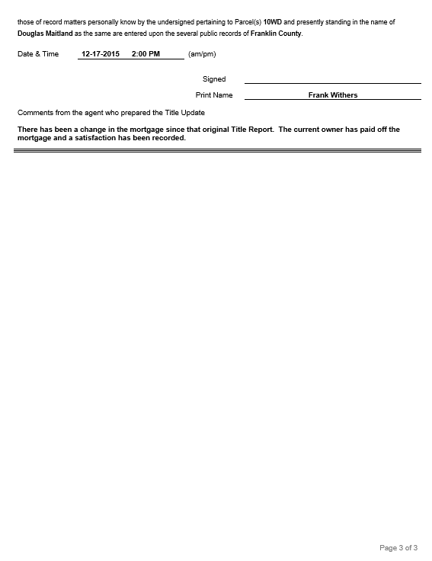
Notation of change
The Title Update

Slide 80
Recent Changes

Slide 81
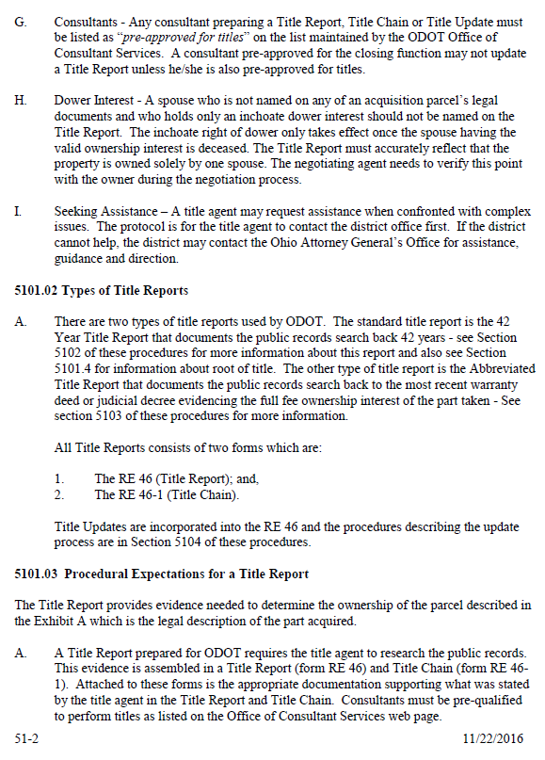

Slide 82
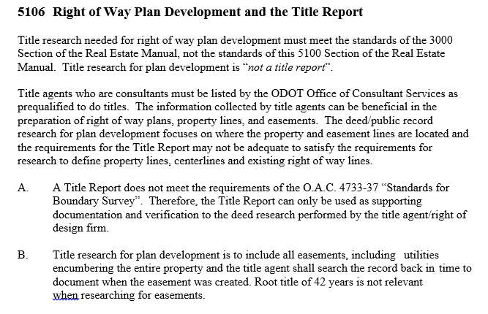
Title research for plan development must meet the standards of the 3000 section of the Real Estate Manual, and not the 5100 section.
Title research for plan development is not a “title report”.
A Title Report “does not meet” the requirements of OAC 4733-37 Standards for a Boundary Survey.
The title research for plan development focuses on where the property and easement lines are located.
The Title Report doesn’t satisfy the requirements for research to define property lines, centerlines and existing RW lines.
Root title of 42 years is not relevant when researching for easements. The agent searches the record back to document when the easement was created.

Slide 83
Other Parts of Title Procedures

Slide 84
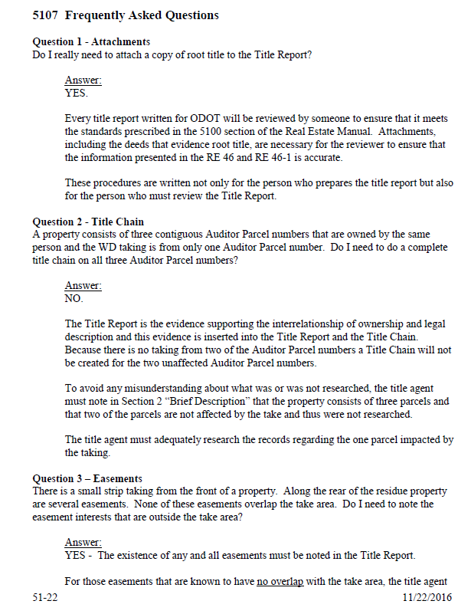
Section 5107 –
Frequently
Asked Questions
__________
13 FAQs

Slide 85
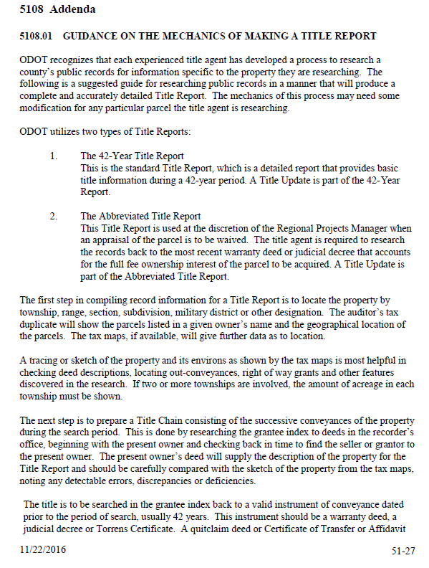
Section 5108.01

Slide 86
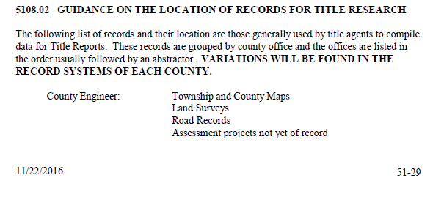
Section 5108.02

Slide 87
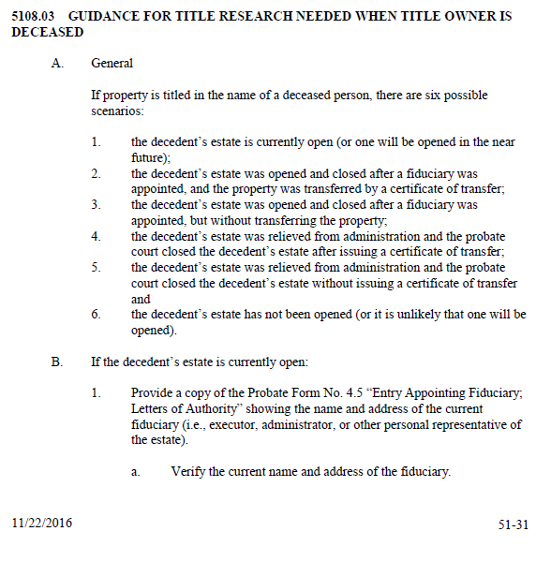
Section 5108.03

Slide 88
Mini Case Study

Slide 89
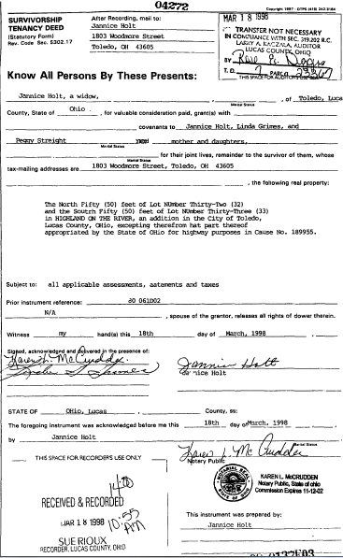

Slide 90
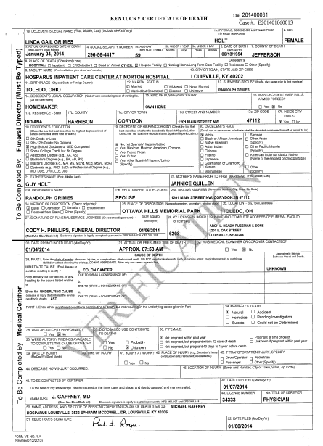
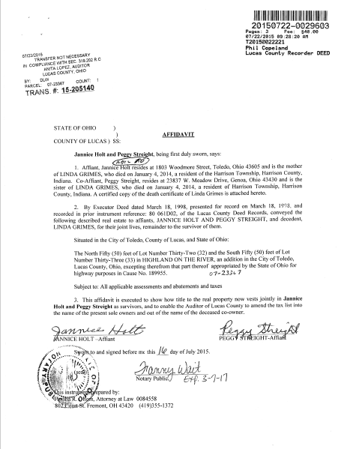

Slide 91
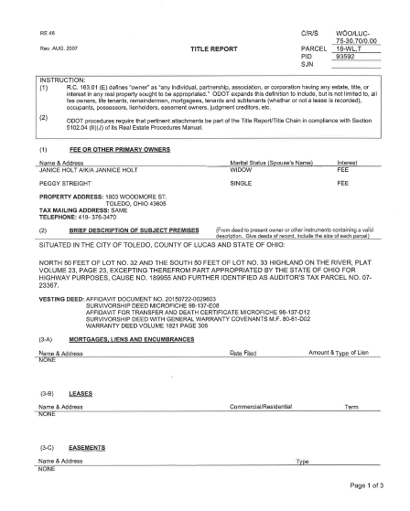
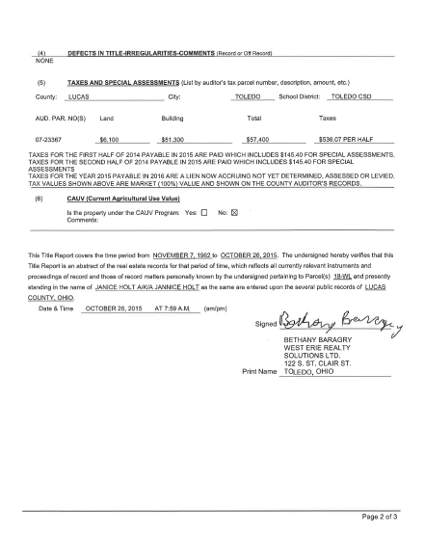

Slide 92
The acquisition is a total take of the residential property
Improved with a home occupied by Mrs. Janice Holt since 1962
FMVE was offered to the owners
Negotiations occurred - all parties agreed to price
_________________________________________________
Peggy Streight, the daughter does not want paid
She wants her mother to receive all of the money
Can this occur and if so, how?
Why are we talking about compensation paid to an owner in a title class?
Because the title issues will affect who ODOT pays and how the owner will be paid.

Slide 93
ODOT cannot be involved with property owner tax issues
Currently, title to the property is…
From the Affidavit
No one person owns more than another
ODOT cannot issue 1 warrant with two names
ODOT will issue 2 warrants with Holt getting 50% and Streight getting 50%
__________________________________________________
The other option…
Streight quit claims her interest to Holt prior to closing
Holt becomes absolute fee owner
Then ODOT can issue 1 warrant to Holt for the full amount of compensation

Slide 94
Titles Needed
For Appropriation
_____________________
Section 5105
of the Real Estate Manual

Slide 95
Titles Needed for Appropriation
If ODOT must take property by exercising its right of eminent domain, the AGO appropriates property on behalf of the Director
Appropriation must comply with ORC 163.01 – 163.22
- These laws require notification to all parties having any interest in the property
- The Title Report is used by the AGO to notify these parties
Titles for Appropriation

Slide 96
Requirements of the AGO
- All Title Reports must be 42 year reports
- The report must be prepared not more than 30 days prior to the parcel file being sent to the AGO
- The report includes the name/address of every owner
- The agent is to secure the residential mailing address of those having any interest in the property.
- Verify if there are tenants:
Verify the name and address of every tenant (does not matter if the lease is recorded or not)
Titles for Appropriation

Slide 97
The agent secures all unreleased mortgages, leases, easements and encumbrances relevant to the take area
If the fee owner operates a business on the property as a tenant – the agent is to obtain:
- The legal name of the tenant company
- Name and address of tenant’s registered agent
If not available, then the address of the company’s headquarters
If not available, verify street address of the tenant’s premises
Titles for Appropriation

Slide 98
If the property is in the name of a corporation or limited liability company, the agent obtains…
- The name and address of the registered agent of the company from the Secretary of the State of Ohio
- If not listed with the Secretary’s Office, then the agent obtains the commercial mailing address of the company
Titles for Appropriation

Slide 99
If in the name of a general partnership, limited partnership, or limited liability partnership, the agent obtains …
- The name and address of the registered agent of the partnership and,
- The names and addresses of all the general partners from the Secretary of the State of Ohio
- If there is no information from the Secretary’s Office, the agent lists the commercial mailing address of the partnership.
Titles for Appropriation

Slide 100
If the property is under a fictitious name registered with the Secretary of State, the agent obtains…
- The name of the parent company and the name/address of the registered agent
If not registered with the Secretary’s Office, the agent secures the commercial address of the parent company
Titles for Appropriation

Slide 101
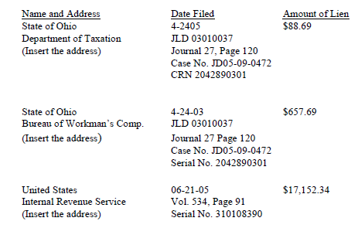
Verify if mortgage, lien, easement or any other right, title or interest has been released.
- Liens are to be listed a certain way on the report:
Titles for Appropriation

Slide 102
Copies of every mortgage, lease, easement or other instrument creating a right, title or interest in the property are attached to the Title Report
If document is lengthy – attach pertinent parts
Pertinent parts can include
First Page
Legal description page
Condemnation/eminent domain clause
Signature page
Titles for Appropriation

Slide 103
If a mortgage is to an individual(s) – verify the name/address of each mortgagee
- Cancelled mortgages, expired leases or other interests that are no longer valid need not be attached
If in doubt – include copies
Verify if there are any active mineral rights on the property and their proximity to the take
- AGO needs this information when deciding if an oil/gas tenant is included in the appropriation case
Titles for Appropriation

Slide 104
Determine if any non-highway or non-utility easement is within the take area, or, is affected by the taking
If not in take or affected by take – note that the easement is not affected
If the easement is affected – then it must be described
- Easements can include ingress/egress; access; and drainage easements
Titles for Appropriation

Slide 105
When dealing with unrecorded leases…
- Diligent efforts must be made to obtain copies of the leases before sending the parcel file to the AGO
- If a copy cannot be obtained, the Negotiator’s Notes must mention the facts relevant to the lease
Titles for Appropriation

Slide 106
Some things to watch out for:
Be sure to search for spelled out names of companies with numbers in their name
A release of mortgage was missed where the mortgagor was “W103 LLC” because it was recorded as “W One Zero Three LLC”
Because this was missed, the bank was mistakenly named in the case as it appeared they still held a mortgage interest in the property
Make sure any existing liens are recorded in section 3-A of the Title Report, “Mortgages, Liens And Encumbrances”
A lien was missed where an Affidavit related to the lien was listed properly in Section 4, but the Lien itself was not listed in Section 3-A
Titles for Appropriation

Slide 107
Some things to watch out for:
Watch out for all possible Assignment of Mortgage documents; the titles can be confusing
An Assignment of Mortgage was missed because the title searcher saw “Assignment of Rents” in the document title and did not list it as an Assignment of Mortgage:
Because this was missed, the Assignment of Mortgage was left out of Section 3-A of the Title Report, and the correct current Mortgagee was not named in the petition
Titles for Appropriation

Slide 108
HIGHWAY PLANS

Slide 110
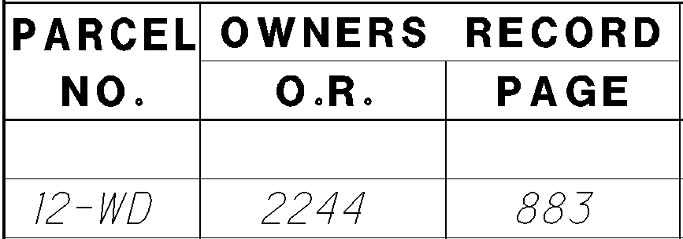

Slide 111
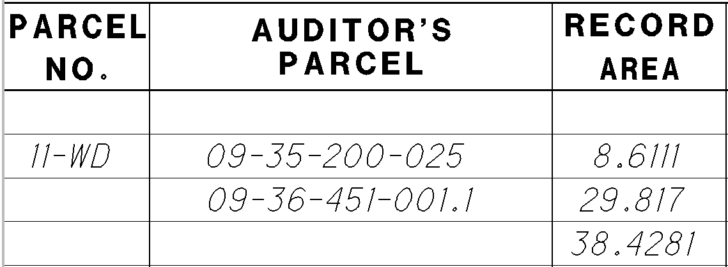

Slide 112
Describes a tract of land by following or tracing its perimeter.
There are several types of these descriptions:
Metes only:
Distance and bearing are only information given
Bounds only:
Adjoining owners are only information given.
Metes and Bounds combination:
Distance, Bearing and Adjoiners information is given.
Distance, Bearing, Adjoiners and Monument established information is given.
Distance, Bearing, Adjoiners, Monument established and Station / Offset information is given.

Slide 113
Point Descriptions:
Station and Offset (left or right) referenced to a platted centerline information is given.
The centerline survey plat should be recorded in the County Recorders Office of the county where the parcel is located.
Offset distance is always perpendicular or radial (perpendicular to curve) to the centerline at the corresponding station.
Legal descriptions using only point descriptions alone are not acceptable for recording in many counties.

Slide 114
Is a combination of a point description and a Metes and Bounds type description.
The Point of Commencement should be an existing monument and acceptable starting point (often determined by the county engineer) shown on the recorded centerline survey plat and be referenced to the recorded centerline.
All bearings shall be referenced to the same basis of bearing as the centerline of survey.

Slide 116
Page 1 of 4
PARCEL 15-SH
WAR-48-19.40
PERPETUAL EASEMENT FOR HIGHWAY PURPOSES
WITHOUT LIMITATION OF EXISTING ACCESS RIGHTS
An exclusive perpetual easement for public highway and road purposes, including, but not limited to any utility construction, relocation and/or utility maintenance work deemed appropriate by the State of Ohio, Department of Transportation, its successors and assigns forever.
Grantor/Owner, for himself and his heirs, executors, administrators, successors and assigns, reserves all existing rights of ingress and egress to and from any residual area. (as used herein, the expression “Grantor/Owner” includes the plural, and words in the masculine include the feminine or neuter).
[Surveyor’s description of the premises follows]
Situated in the State of Ohio, County of Warren, Clearcreek Township, being part of Section 34, Town 4, Range 4 Between the Miami’s also, being part of a 1.827 acre tract conveyed to David L Sr. and Sandra L Schreier (herein after referred to as grantor) as described in the Warren County Recorder’s Office in Official Record 3351, Page 793 and also, being a parcel of land lying on the right side of the centerline plat of State Route 48 made by the Ohio Department of Transportation filed in the records of Warren County and being more particularly described as follows:

Slide 117
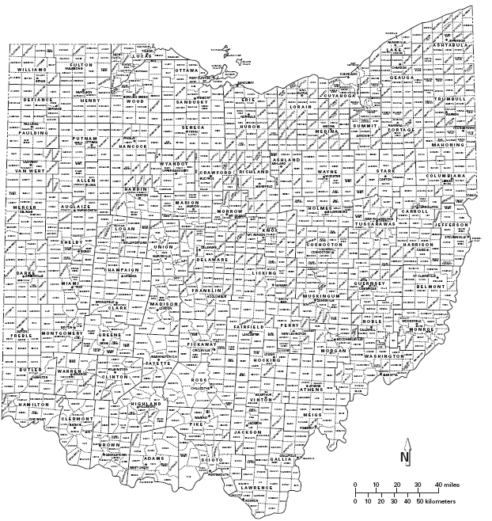
Page 1 of 4
Situated in the State of Ohio, County of Warren,
Clearcreek Township, being part of Section 34,
Town 4, Range 4 Between the Miami’s

Slide 118
Page 1 of 4
Situated in the State of Ohio, County of Warren, Clearcreek Township, being part of Section 34, Town 4, Range 4 Between the Miami’s
Civil Township are areas made for governmental purposes only.
Clear Creek Township, Warren County
In non-rectangular lands Townships refer to only the Civil type of township.

Slide 119
Page 1 of 4
Situated in the State of Ohio, County of Warren, Clearcreek Township, being part of Section 34, Town 4, Range 4 Between the Miami’s

Slide 120
Page 1 of 4
Situated in the State of Ohio,
County of Warren,
Clearcreek Township,
being part of Section 34,
Town 4, Range 4
Between the Miami’s

Slide 121
Situated in the State of Ohio,
County of Warren, Clearcreek
Township, being part of
Section 34, Town 4, Range 4
Between the Miami’s

Slide 122
Page 2 of 4
COMMENCING at the centerline of survey station 1021+39.96 as shown and described on said centerline plat of State Route 48, witness an iron pipe found at the Northwest corner of Lot Number 1 of Ballard Subdivision, bearing South 84̊ 00' 15" East at a distance of 42.57 feet from said commencement point, THENCE with the centerline of survey, North 05̊ 21' 33" East, 144.30 feet to centerline station 1022+84.26 at the Point of Curvature of said centerline of survey;
THENCE continuing with the said centerline of survey on a curve to the right, with an Arc Length of 404.65 feet, a Radius of 1341.96 feet, a Delta Angle of 17̊ 16' 37", a Chord Distance of 403.12 feet and a Chord Bearing of North 13̊ 59' 52" East, to the grantor's South line and at centerline of survey
station 1026+88.91;
THENCE South 78̊ 01' 07" East, 53.58 feet to the Southeast corner of the proposed right of way of said State Route 48 at centerline survey station 1026+99.22, 52.62 feet right;
THENCE with the proposed right of way of said State Route 48, North 18̊ 39' 54" East for a distance of 30.21 feet to an iron pin set at the intersection of the proposed right of way of said State Route48 and the existing right of way of said Pekin Road at centerline survey station 1027+30.50, 49.95 feet right and the TRUE POINT OF BEGINNING of the herein described tract;

Slide 123
Page 3 of 4
THENCE with the proposed right of way of said State Route 48, North 18̊ 39' 54" East for a distance of 46.91 feet to an iron pin set at centerline survey station 1027+78.79, 44.41 feet right;
THENCE with the proposed temporary easement line through said grantor’s tract the 3 following courses:
1) South 32̊ 43' 32" East for a distance of 46.61 feet to an iron pin set at centerline survey station 1027+53.32, 84.22 feet right;
2) South 76̊ 36' 10" East for a distance of 59.99 feet to an iron pin set at centerline survey station 1027+67.27, 142.84 feet right;
3) South 12̊ 57' 30" West for a distance of 11.98 feet to an iron pin set at centerline survey station 1027+54.17, 145.48 feet right at the existing North line of said Pekin Road;
THENCE with the existing North line of said Pekin Road, North 78̊ 01' 07" West, 98.02 feet BACK TO THE TRUE POINT OF BEGINNING.
The above described parcel contains 0.043 acres more or less, which the present road occupies 0.000 acres and resulting in a net take area of 0.043 acres, which is part of Warren County Auditor’s Sidwell Number 09-34-153-013.

Slide 124
4 of 4
North is based on the Ohio State Plane Coordinate System, South Zone (NAD 1983(95)) and are for project use only. This description is based on an actual field survey performed by the Ohio Department of Transportation, District Office 8, under the direct supervision of John Barret P.S., Ohio License Number 7449 and dated April, 2003. This description was prepared by William C. LeRoy P.S., Ohio License Number 7664 and dated May, 2004. Subject to all Easement, Highways, Covenants and Restrictions of Public Record.
Iron pins set in the above description are 3/4 inch diameter rebar, 30 inches in length topped by a 1-1/2 inch diameter aluminum cap stamped "ODOT R/W District 8".
Said stations being the station numbers as stipulated in the hereinbefore mentioned survey and as shown in the right of way plan for WAR-48-19.40, on file in the Department of Transportation, District Office 8, Lebanon, Ohio.
________________________
William C. LeRoy, P.S.
Ohio License Number 7664

Slide 125
http://publications.newberry.org/ahcbp/pages/Ohio.html

Slide 127
CASE STUDIES

Slide 128
CASE STUDY #1
DEVELOPMENT
AND REVIEW OF
A SIMPLISTIC
42 YEAR
TITLE REPORT

Slide 129
HOW IMPORTANT ARE TITLE REPORTS?
Section 5000.03 of the current ODOT manual categorizes the steps to
acquire right of way in this order.
(Reverse Order)
8. Appropriation
5000.03 (1) Title Reports
Regulations require a notice of intent to acquire and good faith offer of compensation be made to the owner. Section 163.01 (E) of the Ohio Revised Code defines “owner” in the State of Ohio. A Title Report is completed to determine the owner of a property to be acquired for the highway project. The procedure for preparing title reports is described in Section 5100 of the Real Estate Manual.
7. Closing
6. Relocation
5. Negotiations
4. Establishing
Just Compensation
3. Appraisal Review
2. Appraisal Report
1. Title Report

Slide 130
WHAT IS A
SIMPLISTIC
TITLE REPORT?
A Simplistic Title Report is one that does not
require extra ordinary effort while compiling
and reporting the information necessary to meet ODOT’s current title procedures as defined in Section 5100 of ODOT’s current Real Estate Manual.

Slide 131
Some Contributing Factors
Of A Simplistic Title Report…
Minimal Amounts Of Divided Or Undivided Interest (Current and Prior Owners)
A Minimal Amount Of Parcels/Tracts of Land Being Researched (Title Chains)
A Minimal Amount Of Voluntary Liens Such As Mortgages, UCC (Financing Statement), Bail Bonds Collateral, etc.
A Minimal Amount Of Involuntary Liens Such As Judgement Liens, Federal Tax Liens, Personal Tax Liens, Mechanics Liens, Child Support Liens Or Any Other Type Of Lien Attached To The Subject Property Not Acquired Voluntarily By The Current or Prior Owners
There Are No Matters On Or Off Record Clouding The Finished Title

Slide 132
THE RE 46 TITLE REPORT (Simplistic Example)

Slide 133
THE RE 46-1 TITLE CHAIN (Simplistic Example)

Slide 134
LOCATION MAP

Slide 136
PROPERTY MAP

Slide 137
DETAIL SHEETS
P/L
T-Parcel
Existing R/W
CH Parcel

Slide 140
Example Sequence For
Developing A Title Report
1. Familiarize Yourself With Project Plans
2. Obtain Auditor’s Card/Print Out
3. Obtain/Review Tax Map
4. Drive Project
5. Execute Title Chain (RE 46-1)
6. Research Recorders Records (All Past And Present Owners)
7. Research Clerk of Courts Records
8. Research Probate Court Records
9. Research Any Other Pertinent County Records
10. Assess compiled information and complete the RE46

Slide 141
Title and Instruction Section
WHAT
WHERE TO FIND IT
County, Route and State
Summary Sheet
(ODOT) Parcel Number
Summary Sheet
Parcel Identification Number
Summary Sheet
State Job Number
Summary Sheet
NOTE: This information can be found on other plan pages. This is just a
guide of the most efficient place to find it.

Slide 142
Project ID
State Job Number
County, Route
and Section
(ODOT) Parcel Number

Slide 143
SUMMARY PAGE
PARCEL INFORMATION

Slide 144
SECTION (1)
FEE OR OTHER PRIMARY OWNERS
WHAT
WHERE TO FIND IT
Name
From Document(s) Granting The Current Owner’s Interest
Address
Auditors Parcel Card/Print Out
Marital Status (Spouse’s Name)
From Document(s) Granting The Current Owner’s Interest
Interest
From Document(s) Granting The Current Owner’s Interest
Procedure
5102.03 (C) (1)

Slide 145
CURRENT DEED INFORMATION
- Volume and Page
- Name(s) of Grantor(s)
- Name(s) of Grantee(s)
- Type of Document
- Address of Grantee(s)
- Brief Legal Description
- Conveyance Fee
- Date Signed by Grantor(s)
- Signature of Grantor(s)
- Date and Time Recorded
- Auditor’s Parcel Number

Slide 146
Some Common Types of Documents
Granting Current Owners Interest
Warranty Deed
General Warranty Deed
Limited Warranty Deed
Survivorship Deed
Fiduciary Deed
Quit Claim Deed
Certificate of Transfer
Auditor’s Deed
Transfer On Death Deed
Transfer On Death
Designation Affidavit
Governor’s Deed
Sheriff’s Deed
Judicial Decree
NOTE: You will discover other types of documents
granting current owner interest.

Slide 147
Where To Locate Various Documents Granting Current Owner’s Interest
- County Recorder’s on Site Computer System
- County Recorder’s Online Computer System
- County Recorder’s Deed Index Books
- County Recorder’s Sectional Index Books
- Other Designated County Index(s)

Slide 148
EXAMPLE RECORDER’S DEED INDEX (Clermont County)

Slide 149
EXAMPLE OF RECORDER’S NAME INDEX
NAME SEARCH (CLERMONT COUNTY DEED INDEX)
INSTRUCTIONS INDIVIDUAL NAMES
Find The First Letter In The Owner’s Surname
2. Find The First Letter In The Owner’s Given Name
3. Find The Sheet Number To The Right Of The Selected Column
INSTRUCTIONS FOR CORPORATIONS AND FIRMS
Find The First Letter Of That Corporation/Firm And Use The Sheet Number Provided At The End Of The Selected Column

Slide 150
EXAMPLE RECORDER’S SECTION INDEX (Butler County)

Slide 151
LIVE
RECORDER’S
WEBSITE
SEARCH

Slide 152
SECTION (2)
Brief Description Of Subject Premises
WHAT
WHERE TO FIND IT
Current Deed(s) or Other Instruments Volume and Page
From Document(s) Granting The
Current Owner’s Interest
Brief Description of Legal
Location(s) & Surface Area(s)
From Document(s) Granting The
Current Owner’s Interest
Auditor’s Parcel Number(s)
Creating The Larger Parcel
Summary Sheet
County Auditor
Procedure
5102.03 (C) (2)

Slide 153
SECTION (3-A)
Mortgages, Liens And Encumbrances
WHAT
WHERE TO FIND IT
Volume and Page
Document
Borrower/Defendant/Plaintiff, ECT.
Document
Lender and Address
Document
Date Filed
Document
Amount and Type of Lien
Document
Procedure
5102.03 (C) (3)

Slide 154
WHAT IS A VOLUNTARY LIEN?
A Voluntary Lien is one that exists
because of an action taken by a
debtor. This type of lien uses the
property of another as security
for the payment of a debt. These
liens are attached most often to real property and not to a person.

Slide 155
PERTINENT MORTGAGE INFORMATION (Voluntary Lien)

Slide 157
CONDEMNATION
LANGUAGE
WHAT DOES THIS MEAN?
Condemnation Language Located In
A Mortgage Explains How Proceeds
Are To Be Distributed In The Case Of
A Eminent Domain Taking.

Slide 158
COMMON TYPES
OF VOLUNTARY LIENS
Mortgages
Financing Statements (UCC)
Land Contract
Note: This is a sample of commonly found Voluntary Liens. You will find other types of liens not included on this list.

Slide 159
Where To Locate Voluntary Liens
- County Recorder’s on Site Computer System
- County Recorder’s Online Computer System
- County Recorder’s Mortgage Index Books
- County Recorder’s Sectional Index Books
- County Recorder’s Miscellaneous Index Books
- Other Designated County Office Index(s)

Slide 160
WHAT IS A INVOLUNTARY LIEN?
An Involuntary Lien is one that exists on
real estate without the property owner’s
voluntary cooperation. It may or may not
be imposed by a court and often evolves
for non-payment of a voluntary lien or
another type of financial agreement where
the property owner does not fulfill his or
her contractual agreement.

Slide 161
EXAMPLE OF A INVOLUNTARY LIEN

Slide 162
COMMON TYPES OF INVOLUNTARY LIENS
AKA NON-CONSENSUAL LIENS
Judgment Liens
Property (Auditor’s)Tax Liens
Federal (IRS) Tax Liens
Child Support Liens
State Tax Lien
Personal Tax Liens
Note: This is a sample of commonly found Involuntary Liens. You will
find other types of liens not included on this list.

Slide 163
Where To Locate Involuntary Liens
- County Recorder’s on Site Computer System
- County Recorder’s Online Computer System
- County Clerk of Courts Online Computer System
- County Clerk of Courts On Site Computer System
- County Recorder’s Mortgage Index Books
- County Clerk of Courts Judgement Entry Books
- County Recorder’s Sectional Index
- County Recorder’s Miscellaneous Index
- Other Designated County Office Index(s)

Slide 164
LIVE
CLERK OF COURTS
AND
PROBATE COURT WEBSITE
SEARCH

Slide 165
SECTION (3-B)
LEASES
WHAT
WHERE TO FIND IT
Volume and Page
Date Recorded
Document
Lessee and Lessor
(Including Name and Address)
Document
Commercial/Residential
Document
Term
(Commencement Date/Length of Lease, Etc.)
Document
Procedure
5102.03 (C) (4)

Slide 166
Where To Locate Leases
- County Recorder’s on Site Computer System
- County Recorder’s Online Computer System
- County Recorder’s Mortgage Index Books
- County Recorder’s Sectional Index Books
- County Recorder’s Lease Index Books
- County Recorder’s Miscellaneous Index Books
- Other Designated County Office Index Books

Slide 167
EXAMPLE OF LEASE (LAND)

Slide 168
EXAMPLE OF LEASE (Oil and Gas)

Slide 169
SECTION (3-C)
Easements
WHAT
WHERE TO FIND IT
Volume and Page
Date Recorded/
Document
Name and Address(s)
of Grantor(s) and Grantee(s)
Document
Type of Easement
Document
In Take Area?
Document and Plans
Procedure
5102.03 (C) (5)

Slide 170
Where To Locate Easements
- County Recorder’s on Site Computer System
- County Recorder’s Online Computer System
- County Recorder’s Deed Index Books
- County Recorder’s Sectional Index Books
- County Recorder’s Easement Index Books
- County Recorder’s Miscellaneous Index Books
- Other Designated County Office Index Books

Slide 171
EXAMPLE OF EASEMENT

Slide 172
EXAMPLE OF EASEMENT CONTINUED

Slide 173
SECTION (4)
DEFECTS IN TITLE-IRRGULARITIES-COMMENTS
WHAT
WHERE TO FIND IT
Defects In Title-Irregularities-Comments
(Record or Off Record)
Any/All documents obtained
or which you are unable to obtain during the research process and…
Various Departments
Within The County where
Research Was Completed
Procedure
5102.03 (C) (6)

Slide 174
COMMON TYPES OF DEFECTS-IRRGULARITIES-COMMENTS
- Missing Link(s) In Title Chain
- Missing Interest With Current Owner(s)
- Current Owners Are Getting Divorced
- Clerk Knows Your Property Owner Is Deceased, But You Find
Nothing On Record Indicating This Information Is Accurate
- A Ohio Secretary of State’s Business Search Does Not Show
The Ohio Based Company You Are Researching

Slide 175
DEFECTS IN TITLE-IRRGULARITIES

Slide 176
EXAMPLE DEFECTS IN TITLE-IRRGULARITIES CONTINUED

Slide 177
EXAMPLE DEFECTS IN TITLE-IRRGULARITIES CONTINUED

Slide 178
EXAMPLE RECORDER’S MISCELLANEOUS INDEX (Clermont County)

Slide 179
SECTIONS (5) and (6)
Taxes and Special Assessments/CAUV
WHAT
WHERE TO FIND
County /Township/School District
Auditor’s Card/Print Out
Auditors Parcel Number
Auditor’s Card/Print Out
Land/Building/Total
Auditor’s Card/Print Out
Taxes/Special Assessments/Delinquent Taxes
Auditor’s Card/Print Out
Homestead Exemption
Auditor’s Card/Print Out
CAUV Information
Auditor’s Card/Print Out
Procedure
5102.03 (C) (7) and 5102.03 (C) (8)

Slide 180
EXAMPLE AUDITOR’S CARD

Slide 182
LIVE
AUDITOR’S
WEBSITE
SEARCH

Slide 183
Verification Section
Start Date – Date Root Deed Was Recorded (Title Chain, RE 46-1)
Ending Date – County Office(s) Certification Date. Usually On The Computer,
But Can Be Located In Another Designated Area. Always Check
With The Recorder Office, The Clerk of Courts and Probate Court For The Current Certification Date.
Parcel(s) – Title Section (RE 46)
Name – Same as in Section 1 (RE 46)
Public Records – The County Research Was Completed In
Date & Time – Recorder’s Office Certification Date (See Above For Details)
Signature – ONLY The Person Who Completed The Research May Sign
Procedure – 5102.03 (C) (9) (a) and (b)

Slide 185
RE 46-1
Header Section
WHAT
WHERE TO FIND
District
Varies
County, Route, Section
Summary Sheet
ODOT Parcel Number
Summary Sheet
Parcel Identification Number
Summary Sheet
Procedure
5102.04 (F) (1)

Slide 186
RE 46-1 Grantor and Grantee Information
WHAT
WHERE TO FIND
Grantor
From Document(s) Granting
The Current Owner’s Interest
Grantee
From Document(s) Granting
The Current Owner’s Interest
Procedure
5102.04 (F) (2) (a), (b), (c)
and 5102.04 (F) (3) (a) and (b)

Slide 187
RE 46-1 Additional Information
WHAT
WHERE TO FIND
Type of Instrument
From Document(s) Granting The Current Owner’s Interest
Date Signed
From Document(s) Granting The Current Owner’s Interest
Date and Time Recorded
From Document(s) Granting The Current Owner’s Interest
Volume and Page
From Document(s) Granting The Current Owner’s Interest
Guidance
5102.04 (F) (4), (5), (6) and (7)

Slide 188
RE 46-1 Additional Information
WHAT
WHERE TO FIND
Brief Land
Description Remarks
From Document(s) Granting
The Current Owner’s Interest
From Document(s) Granting
The Current Owner’s Interest
Conveyance Fee
Procedure
5102.04 (F) (8) (a), (b), (c), (d) and
5102.04 (F) (9)

Slide 189
LIST OF ATTACHMENTS
Copy Of Auditor’s Card/Print Out
Copy Of Current Deed Found In O.R. Volume 532 Page 411
Copy Of Root Deed Found In Deed Volume 434 Page 179
Copy Of Mortgage Found In O.R. Volume 1613 Page 2016
Copy Of Power Of Attorney Found In O.R. Volume 530 Page 719

Slide 190
BUILDING THE TITLE REPORT
Order of Attachments in a Completed Title Report
Title Report (RE 46)
2. Title Chain(s) (RE 46-1)
3. Auditor’s Card/Printout for all parcels
4. Current Deed(s) In Chronological Order
5. Root Deed(s) In Chronological Order
Other Pertinent Deed(s)
(Example: Deed Containing a reverter clause, restrictive covenvent and/or exceptions.)
7. Any Mortgages, Liens and/or Encumbrances (Including Assignments)
*In the order as listed in Section (3-A)
8. Any Lease (Including Assignments)
*In the order as listed in Section (3-B)
9. Any Easements (Including Assignments)
*In the order as listed in Section (3-C)
10. Any documents listed in Section (4)
*In the order as listed in this section

Slide 191
TITLE CHAIN INFORMATION
FROM CURRENT DEED
- Volume and Page
- Name(s) of Grantor(s)
- Name(s) of Grantee(s)
- Type of Document
- Brief Legal Description
- Conveyance Fee
- Date Signed by Grantor(s)
- Date and Time Recorded

Slide 192
CASE STUDY #2
DEVELOPMENT
AND REVIEW OF
A COMPLEX
42 YEAR TITLE REPORT

Slide 193
WHAT IS A
COMPLEX
TITLE REPORT?
A Complex Title Report is one that may require extra ordinary effort while compiling and reporting the information necessary to meet ODOT’s current title procedures as defined in Section 5100 of ODOT’s current Real Estate Manual and/or may contain either or both irregularities and defects that prohibit the execution of a clear title report.

Slide 194
Some Contributing Factors
Of A Complex Title Report…
Multiple Amounts Of Divided, Undivided or Unaccounted for Interest (Current and Prior Owners)
Multiple Amounts Of Parcels/Tracts Of Land Being Researched (Title Chains)
Current Owner(s) are deceased
Multiple Voluntary Liens Such As Mortgages, UCC (Financing Statement),
Bail Bonds Collateral, etc.
Multiple Assignments of Voluntary Liens
Multiple Involuntary Liens Such As Judgement Liens, Federal Tax Liens,
Personal Tax Liens, Mechanics Liens, Child Support Liens Or Other Type
Of Lien Attached To The Subject Property Not Acquired Voluntarily By
The Current or Prior Owners
Matters On Or Off Record Clouding The Finished Title

Slide 195
THE RE 46 TITLE REPORT (Complex Example With Flaws)

Slide 196
THE RE 46 TITLE REPORT (Complex Example With Flaws Continued)

Slide 197
THE RE 46-1 TITLE CHAIN (Complex Example)
Notice There Are
27 More Pages

Slide 198
THE SUMMARY SHEET

Slide 199
BLOW UP OF SUMMARY SHEET

Slide 203
COMPLEX TITLE EXAMPLE BOUNDARY SHEET
T-2
WD
T-1
T-3

Slide 204
T-2
WD
T-1
T-3

Slide 206
CURRENT DEED COMPLEX TITLE EXAMPLE

Slide 207
CURRENT DEED COMPLEX TITLE EXAMPLE CONTINUED

Slide 208
CURRENT DEED COMPLEX TITLE EXAMPLE CONTINUED

Slide 209
COMPLEX TITLE SECTION (4) EXAMPLE

Slide 210
COMPLEX TITLE SECTION (4) EXAMPLE CONTINUED

Slide 211
Mineral Rights & Title Reports

Slide 212
FREQUENTLY ASK QUESTION
Question: What is a Title Cloud?
Answer: A title cloud is anything in the property’s ownership history that raises questions about
an owner’s legal claim to the property. Examples include Old Mortgages not released, a
failure to properly transfer all interest in the real property such as mineral rights to a former
owner or an unresolved legal debt or levy by a creditor or a taxing authority.
Question: I can get copies of what I need off the recorders web site, but each page has a
watermark on it. Can I still use it in my title report?
Answer: For title reports solely used to negotiate a parcel that ends in a competed acquisition without
the parcel being appropriated, there is no problem using watermarked copies. If the parcel
does go to the Attorney Generals Office for appropriations, you will want to consult with the
Attorney Generals represented that is handling the case to see if he or she wants copies
that are not watermarked.
Question: The parcel is for a small Temporary Easement for Grading and Seeding. Do I need to even
do a Title Report?
Answer: Yes. Section 5101.01 (A) states that “For every acquisition, there must be a title report.”
However, Section 5103.01 does give the District Office the option to execute an Abbreviated
Title Report when the FMVE offered to an owner will be based on the waiver of appraisal.

Slide 213
FREQUENTLY ASK QUESTION CONTINUED
Question: What do I need to do for a Title Update when the parcel goes to appropriations?
Answer: Section 5105.02 of the manual shows exactly what is needed when preparing the final Title
Report or Title Update.
Question: I have a Title with 3 different chains for the parcel being researched. Each of the chains end with
the same root deed. Can I put them all on the same chain?
Answer: No. Combining all 3 Title Chains will confuse anyone needing to read this report. Each chain
will have its own separate Title Chain and will identify what Auditor Parcels Number is being
researched in the heading.
Question: I have discovered the current owner is deceased. What do I show from the estate case?
Answer: Letters of Authority, and any documents providing the names of the surviving spouse, children and/or
next of kin. If possible also include the deceased final will along with any other significant information
found in the probate case file. See Section 5107.03 of the manual for specifics.
Question: I am doing the third update for a parcel. It’s not an appropriation case, can use the last date
it was updated as my start date?
Answer: No. When completing a Title Update the agent must research the records from the current date
back to the date of the original Title Report, no matter how many previous updates have been
completed. See Section 5104.02 (C) of the manual for more specifics.

Slide 214
HELPFUL HINTS
Always Familiarize Yourself With The Project, Plans and Subject. Knowing Your Area Of Take Could Save You Unnecessary Search Time.
If You Are Not Sure If Something You Discover During Your Research Is Relevant To The Subject Property Or It’s Owner(s), Lean Toward The Side Of Caution And Include It In Your Final Report. It Is Easier To Remove Something Out Of A Finished Title Report Or Title Chain Than It Is To Add It.
Don’t Add “Fluff” To Your Final Report. Adding Things Such As Released/Cancelled Mortgages, Expired Leases, Released Judgement Liens, Etc.. Only Complicates Things For Anyone Needing To Use And/Or Review Your Report. It Could Also Reflect A Negative Image On Your Qualifications As A Title Agent.
- Your Best Friend At An Unfamiliar County Is The Person Behind The Counter. They Work
There, They Know Where Everything Is, And If They Don’t They Can Find Out Where It Is.
88 Counties Equals 88 Different Ways Of Indexing Things And To Complete An Accurate Title
Report You Need To Know Where They Are.
Don’t Expect Someone Else To Do The Work You Are Suppose To Do. If You Need A Copy,
Go Get It. Your Title Is Not Complete Until All Necessary Copies Are Included. Don’t
Turn It In Assuming The Negotiator Will Get It If They Need It.

Slide 215
MORE HELPFUL HINTS
Don’t Get Lazy When Inserting Information On the RE 46 and RE 46-1. Leaving Out
Information Such As Whether A Deed Came From An Official Record (O.R.) Or A Deed
Volume Might Confuse The User, Especially In Appropriation Cases Sent To The Attorney
General’s Office. A Couple Of Extra Key Strokes Now, Could Save You Unnecessary Wasted
Time Later.
Always Read Documents Closely. You Need To Report Everything Found During Your Research
That Is Pertinent. By Not Reading The Documents Found, You Could Miss Important Facts.
- Never Give Your Opinion In Regards To Any Legal Concerns When Completing Your Report.
This Could be Constituted Practicing Law. See Section 5101.01 (F) Of The Manual For More
Details.
Type Up Your RE 46 And RE 46-1 As If The Person Who Is Going Read It Has No Prior Knowledge Of Title Reports and Title Chains. Keep It Simple, But Informative. Remember
Your Finished Report Must Have Enough Sufficient Information To Be Understood and
Verified By All Users.
- Use Your Common Sense When Executing Titles And Research. If It Doesn’t Make Sense To
To You, Or You Find It Hard To Understand, Do You Think Someone Else Will Be Able To
Make Sense Of It?

Slide 216
THANK YOU!!!

